Slide 1

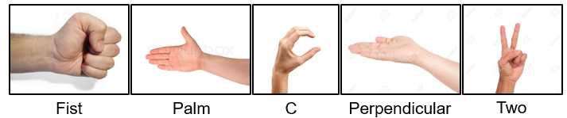
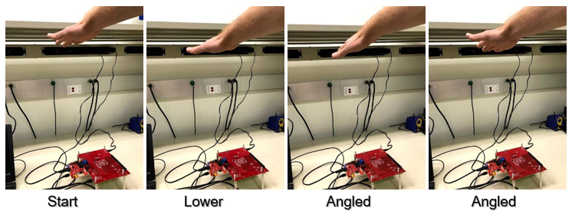
Real-Time Machine Learning-Based Gesture Recognition on mmWave Radar
J. Smith, B. Ramanidharan, T. Shiva Shankar, M. Torlak, Y. Makris
The University of Texas at Dallas, 800 W. Campbell Rd. Richardson, TX 75080
Motivation
Background
Leverage depth information provided by mmWave radar for improving static hand gesture recognition in real-time.
Hand gesture recognition is an integral part of human-computer interaction. This user interaction strongly benefits from the use of wireless sensing allowing the user freedom from wearing any physical devices.
Most gesture recognition techniques use only 2D imaging.
TI mmWave AWR1443 is a low-power FMCW radar sensor with an integrated ARM R4F processor and a hardware accelerator, which aids in real-time radar data retrieval and processing.
Using 1 Tx and 4 Rx antennas and a 4GHz bandwidth from 77-81GHz, the sensor will capture depth and horizontal 2D information with a wavelength of ~4mm.
Machine learning has surpassed the ability of the human eye for image recognition with its ability to identify features and classify images with higher accuracy.
Problem Statement
Develop real-time gesture recognition algorithm using machine learning with advanced capabilities by providing 3D radar information about the gesture and using radar to scan through multiple opaque surfaces. While previous
Proposed Solution
Though the sensor captures the essential data, there is no direct link between the data and the gesture. This is where machine learning is used for recognition and classification.
Solution:
Using radar 3D data, a machine learning algorithm will be trained to classify gestures. A user interface will allow for real-time application of this algorithm to classify hand gestures on-the-fly.
Method:
Using 77-81GHz TI mmWave hardware, we will capture range FFT data from our 4 receive channels for each of the 5 proposed gestures as well ‘no gesture’ option.
For each of the gestures, we will capture datasets of 2000 captures for training the machine learning algorithm.
The support vector machine will be trained to classify the gestures.
A MATLAB based graphical user interface will be designed to capture data in real-time, classify the gesture using the SVM, and present the classification to the user.
Results
Summary
Description
Description
Future Work
Publications
Acknowledgments

